Slide 1
Understanding Cyber Crime and Cyber Offenses

Slide 2

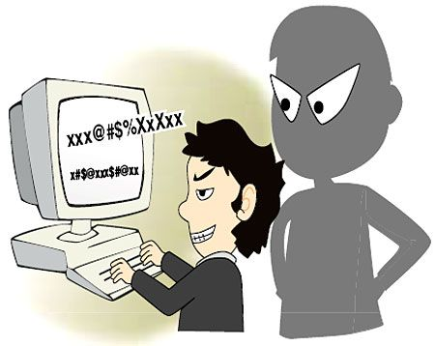
KEYLOGGERS AND SPYWARES
Keystroke logging
Practice of noting the keys struck on a keyboard

Slide 3
KEYLOGGERS AND SPYWARES
SOFTWARE KEYLOGGERS:
  Located between the OS and the keyboard hardware and every stroke gets recorded.
  Installed via Trojans or viruses.
  It consists of 2 files that gets installed in a same directory:
    Dynamic Link Library (DLL):- does all the recording of the keystrokes
    EXEcutable (EXE) file that installs DLL

Slide 4
SOME EXAMPLES OF SOFTWARE KEYLOGGERS
soft-central.net
spytech-web.com
stealthkeylogger.org
blazingtools.com
mykeylogger.com
x-pcsoft.com
cyberspysoftware.com

Slide 5
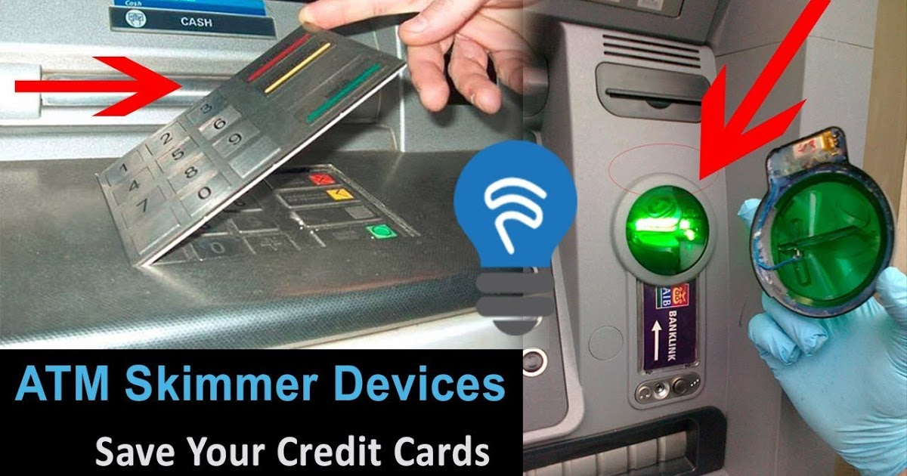
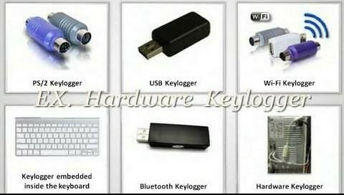
KEYLOGGERS AND SPYWARES
HARDWARE KEYLOGGERS:
  It is physical access to install the keyloggers.

Slide 6
ANTI-KEYLOGGER
Anti-keyloggers can detect installation of keyloggers as firewalls can’t
This software does not require regular updates as other anti-virus softwares
Prevents internet banking frauds
It prevents ID theft
Secures E-mail, instant messaging/chatting

Slide 7
SPYWARES
A type of malware which when installed on a PC collects all the user information without user’s knowledge
It’s presence can’t be detected..hence SPYWARE.
Eg:
  . e-spy-software.com
  spectorsoft.com
  remotespy.com

Slide 8
PHISHING
While checking E-mail one day a user finds a message from the bank threatening him/her to close the bank if he/she doesn’t reply immediately.
It is difficult to conclude whether the msg is fake or not.
Such messages or E-mails can steal personal or financial data, can infect the system with viruses.
These messages can mimic as coming from any Bank, or from legitimate shopping sites such Amazon or eBay.

Slide 9
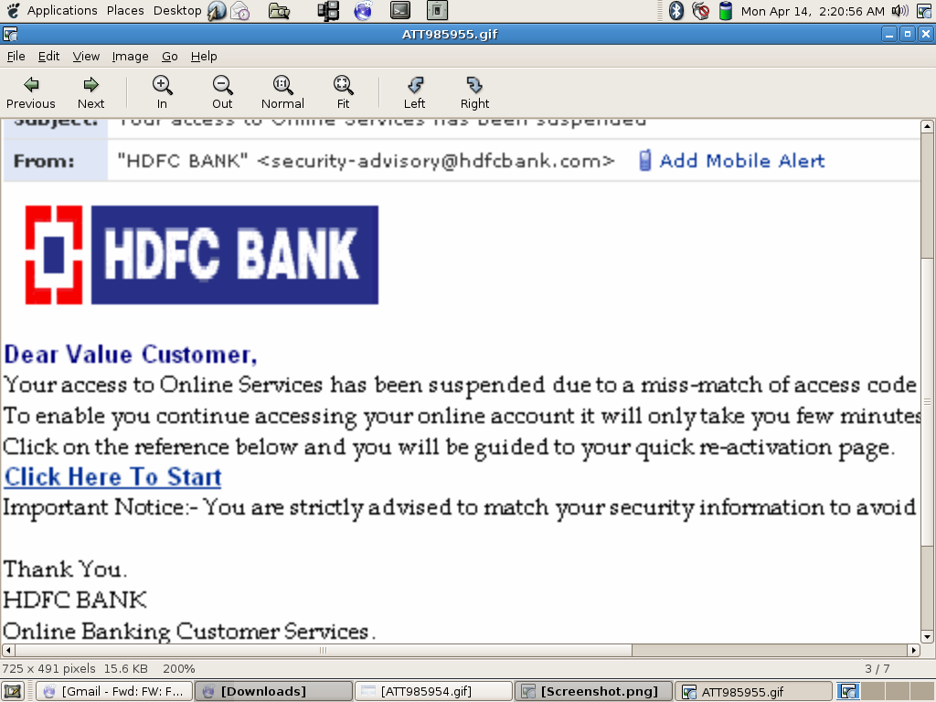
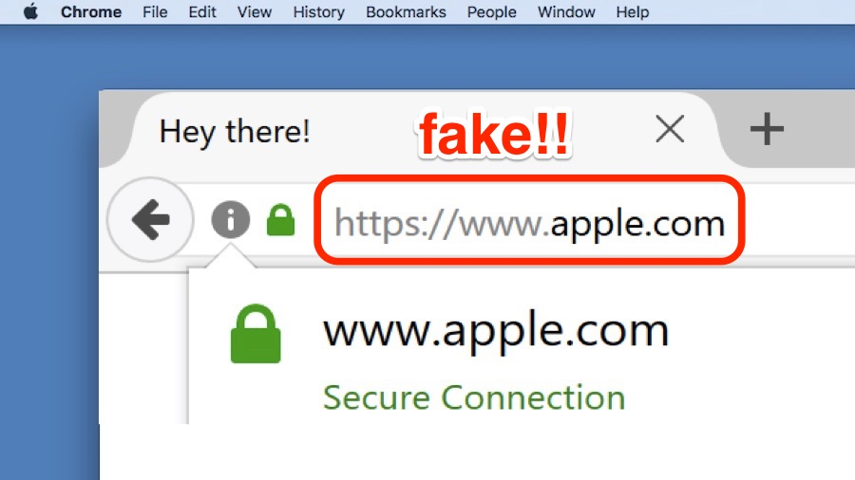
PHISHING

Slide 10
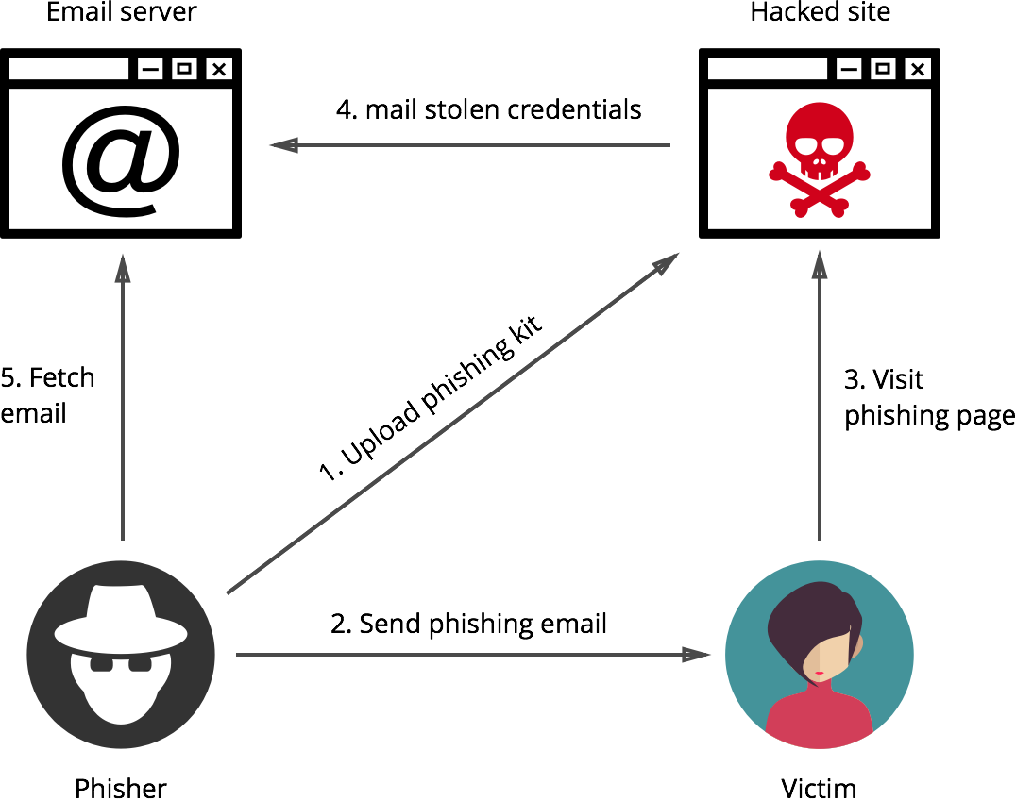
HOW PHISHING WORKS?
Planning: “ Phishers” decide the target & determine how to get E-Mail address of targets.
Setup: Once the target (business/ business house) is decided to spoof then the plan to deliver the messages & to collect the data is created.
Attack
Collection: Victim’s info is recorded by entering into webpages or pop-up windows.
Identity theft & fraud

Slide 11
METHODS OF PHISHING
Dragnet: A false information is included in an E-Mail to take the victims on to the fraud websites or pop-up windows where they are requested to enter bank or credit card details.
Rod and steel: specific prospective victims are already recognized and convey the false information to them to prompt the disclosure of their personal and financial data. Eg, on the phony webpage, availability of similar product on other website with a least price might be shown where all the credit card credentials will be asked.
Losterpot: https://www.microsoft.com/protect/fraud/phishing/symptoms.aspx
Gillnet: merely, by opening one E-Mail or browsing a particular website netizens can find Trojan Horse infected into the system.

Slide 12
PHISHING TECHNIQUES
URL manipulation:
Eg: instead of www.abcbank.com (a legitimate weblink) www.abcbank1.com (false weblink) is provided.
Filter Evasion:
Webpage forgery: phisher directs the netizens to the website developed by him.
Flash Phishing:
Social Phishing:
Phone phishing:

Slide 13
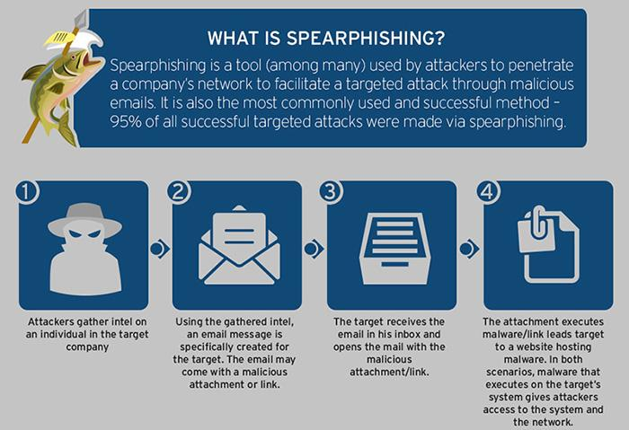
SPEAR PHISHING

Slide 14
Steganography:
Steganography is the art and science of writing hidden message in such a way that no one, apart from the sender and intended recipient, suspects the existence of the message.
Steganography works by replacing bits of useless or unused data in regular computer files (such as graphics, sound, text, html or even floppy disks) with bits of different, invisible information.

Slide 15
This hidden information can be plain text, cipher text or even images.
In modern steganography, data is first encrypted by the usual means and then inserted, using a special algorithm, into redundant data that is part of a particular file format such as a JPEG image, Bitmap image.

Slide 16
Steganography process :
  Cover-media + Hidden data + Stego-key = Stego-medium
Cover media:
  It is the file in which we will hide the hidden data
  Cover-media can be image or audio file.
stego-key:
  Cover-media can be encrypted using stego-key:
stego-medium.
  The resultant file is of above process called stego medium.

Slide 17
Types Of Steganography
  Text Steganography
  Image Steganography
  Audio Steganography

Slide 18
Examples of Text Steganography
Since everyone can read, encoding text
in neutral sentences is doubtfully effective
Since Everyone Can Read, Encoding Text
In Neutral Sentences Is Doubtfully Effective
‘Secret inside’

Slide 19

  Image Steganography

Slide 20
Audio Steganography
It is a technique used to transmit hidden information by modifying an audio signal in an imperceptible manner. It is the science of hiding some secret text or audio information in a host message. The host message before steganography and stego message after steganography have the same characteristics.

Slide 21
Advantages:
  No one suspects existence of message
  Highly secure
Disadvantages:
  It requires a lot of overhead to hide a relatively few bits of information

Slide 22
Examples of Steganography in Cyber Attacks
E-COMMERCE PAGES
Dutch cybersecurity firm Sansec discovered in September of 2020 that cybercrime groups were using image steganography to steal payment information from online stores’ checkout pages.
This type of “skimming” attack is common. In it, hackers add malicious software into the code of a retailer’s checkout page. When a shopper enters their payment details, those details are recorded and sent to a server in a remote location.
Sansec founder Willem de Groot said the firm has detected more than 50,000 online stores in the last six years that have fallen victim to skimming malware.

Slide 23
Steps of steganography
Step 1: Determine the Image Steganography Attack Target and Payload
Step 2: Alter an Image Using Steganography
Step 3: Extract the Malicious Image Code

Slide 24
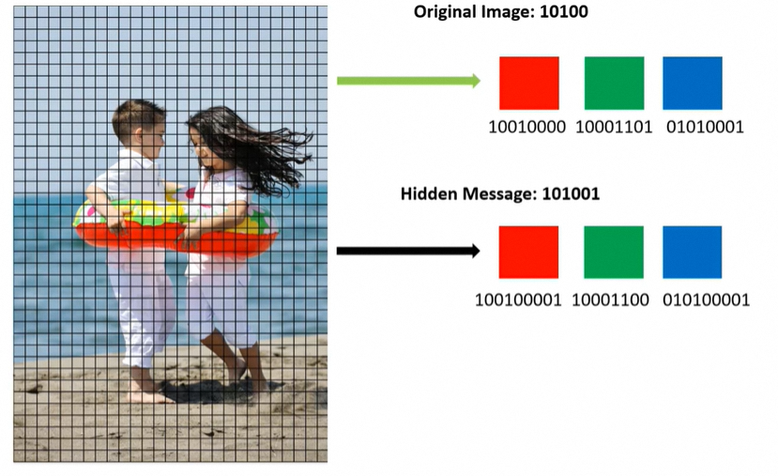

Slide 25
DOS and DDOS attacks

Slide 26
Bot and Botnet
A bot, short for "robot", is a type of software application or script that performs automated tasks on command.
Bad bots perform malicious tasks that allow an attacker to remotely take control over an affected computer.
Once infected, these machines may also be referred to as zombies.
Although taking over one computer is useful, the real value to a criminal comes from collecting huge numbers of zombie computers and networking them so they can all be controlled at once to perform large-scale malicious acts. This type of network is known as a "botnet".
The largest use of bots is in web spidering (web crawler), in which an automated script fetches, analyzes and files information from web servers at many times the speed of a human.
More than half of all web traffic is made up of bots.

Slide 27
Bot and Botnet
Most botnets have an extremely small footprint, meaning they bog your system down or use a lot of system resources, so it can be difficult to recognize when your machine is being used by a criminal for malicious purposes.
A malicious use of bots is the coordination and operation of an automated attack on networked computers, such as a denial-of-service attack.
Botnets can be used to perform distributed denial-of-service attack (DDoS attack), steal data, send spam, and allows the attacker to access the device and its connection.

Slide 28
Denial of Service Attacks
Denial-of-Service (DoS) attack is an attempt by attacker to prevent legitimate users from using resources
Denial-of-Service denies a victim (host, router, or entire network) from providing or receiving normal services

Slide 29
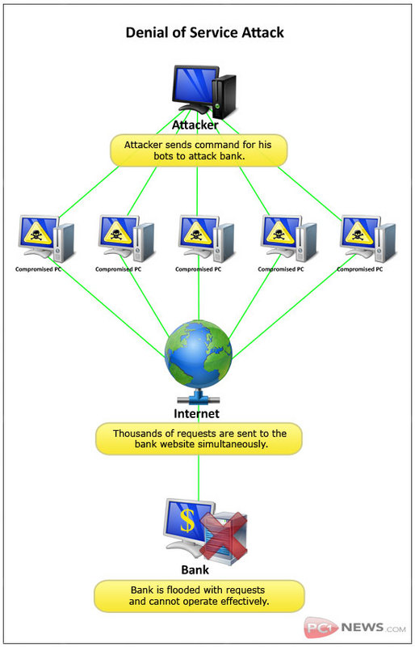
Denial of Service Attacks
  Exploit system design weaknesses
    Ping of death
    Teardrop
  System patches issued after discovering such attacks
  DDoS attack ( Flooding-Based)
    Exploit the computing power of thousands of vulnerable, unpatched machines to overwhelm a target or a victim
    CPU, Memory, bandwidth exhaustion

Slide 30
Classification of DoS Attacks
Bandwidth/Throughput Attacks
Logic Attacks
Protocol Attacks
Unintentional DoS Attacks

Slide 31
Bandwidth/Throughput Attacks
1. Bandwidth Attacks
These attacks flood the network with too much traffic (data, requests, or junk information).
The goal is to use up the internet bandwidth so that real users cannot access the service.
Example: Sending millions of fake requests to a website until it slows down or crashes

Slide 32
Logic Attacks
2. Logic Attacks
These attacks exploit weaknesses or bugs in software, operating systems, or applications.
Instead of sending huge traffic, the attacker sends special malicious inputs that cause errors or crashes.
Example: Sending a request that makes a web server hang or stop responding.

Slide 33
Protocol Attacks
3. Protocol Attacks
These attacks target the communication rules (protocols) that devices use to talk to each other (like TCP, HTTP, ICMP).
The attacker abuses these rules to overload servers or networking equipment.
Example: SYN Flood attack – sending lots of half-open connection requests that fill up server resources.

Slide 34
Unintentional DoS Attacks
4. Unintentional DoS Attack
Not all DoS attacks are caused by hackers.
Sometimes, a sudden rush of real users can overload a system.
Example: When thousands of people try to book movie tickets online at the same time, the server may crash.

Slide 35
Types or Levels of DoS Attacks
Flood Attack (ping flood)
Ping of death Attack (ICMP Packet)
SYN Attack (TCP SYN flooding)
Teardrop Attack
Smurf Attack
Nuke Attack

Slide 36
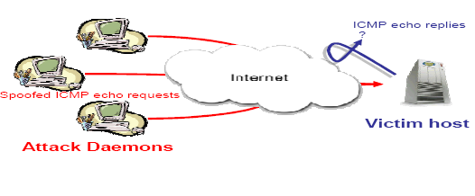
Types or Levels of DoS Attacks
Flood Attack (ping flood)
In this attack, the attacker sends a huge number of ping (ICMP Echo Request) messages to the victim.
The victim’s system has to reply to each ping, which consumes processing power and network bandwidth.
If too many requests come at once, the system slows down or becomes unavailable.
Example: Imagine someone calling your phone non-stop so you cannot answer important calls.

Slide 37
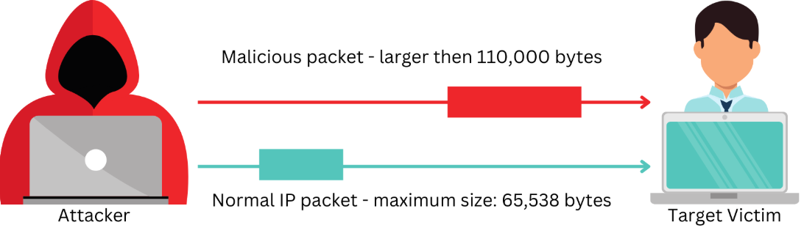
Types or Levels of DoS Attacks
Ping of death Attack (ICMP Packet)
Normally, a ping packet has a limited size (up to 65,535 bytes).
In this attack, the attacker sends an oversized or corrupted ping packet.
When the victim’s system tries to process it, it may crash, freeze, or restart because it cannot handle such a packet.
Example: Like sending a box too large for the door, and when the receiver tries to pull it inside, the door breaks.

Slide 38
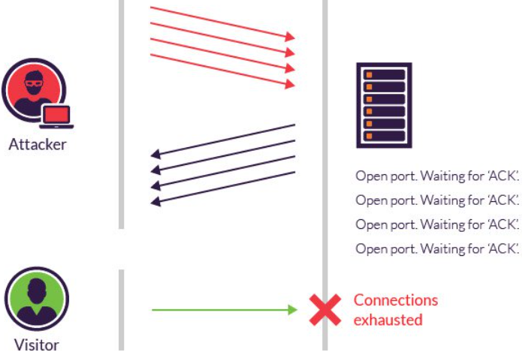
Types or Levels of DoS Attacks
SYN Attack (TCP SYN flooding)
In normal communication, a 3-way handshake happens:
  Client → SYN
  Server → SYN-ACK
  Client → ACK
In this attack, the attacker sends many SYN requests but never sends the final ACK.
The server keeps waiting, using up memory and resources.
When resources run out, real users cannot connect.
Example: Many people knock on your door pretending they want to enter, but they never step inside. You keep waiting and get too busy to welcome real guests

Slide 39
Types or Levels of DoS Attacks
Teardrop Attack
Data sent over the internet is broken into small packets and then reassembled at the receiver’s side.
In this attack, the attacker sends packets with overlapping or confusing offsets.
When the victim tries to reassemble them, it gets confused and crashes.
Example: Imagine receiving a jigsaw puzzle where the pieces don’t fit together. You get frustrated and give up.

Slide 40
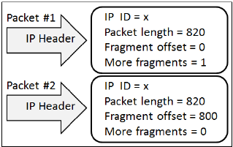
Types or Levels of DoS Attacks
Teardrop Attack: Example
Packet #1
Length = 820 bytes (size of this fragment).
Fragment offset = 0 → This is the first piece (starts at the beginning).
More fragments = 1 → Tells the receiver: “Yes, more pieces are coming.”
Packet #2
Length = 820 bytes (size of this fragment).
Fragment offset = 800 → This fragment should be placed after 800 bytes of the original message.
More fragments = 0 → Tells the receiver: “This is the last piece.”

Slide 41
Types or Levels of DoS Attacks
Smurf Attack
The attacker sends a ping request to a large number of computers on a network, but uses the victim’s IP address as the sender.
All those computers reply to the victim at once.
The victim is flooded with replies and becomes overloaded.
Example: Telling a whole crowd that your friend is giving out free food at his house, so everyone runs there at once, overwhelming him.

Slide 42
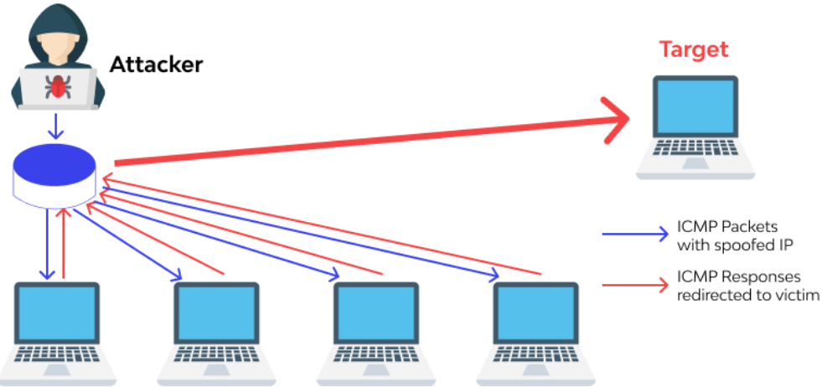
Types or Levels of DoS Attacks
Smurf Attack: Example
Attacker (the hacker)
Sends fake ICMP packets (like ping requests).
These packets are made to look as if they came from the Target’s IP address (this is called IP spoofing).
Middle computers (network of devices)
These devices receive the ping request.
Since it looks like the request came from the Target, they all send back replies (ICMP responses) to the Target.
Target (victim computer)
Suddenly receives a flood of ICMP responses from many devices at the same time.
This overloads the target computer, making it slow, freeze, or crash

Slide 43
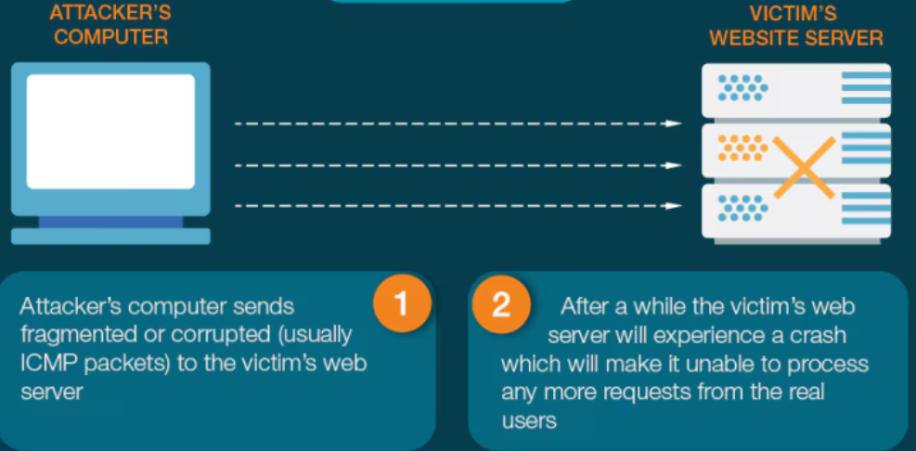
Types or Levels of DoS Attacks
Nuke Attack
The attacker sends corrupted, strange, or invalid packets repeatedly to the victim.
These packets confuse the operating system, sometimes causing errors, freezing, or crashing.
Example: Like sending nonsense letters to someone’s mailbox again and again until the mailbox breaks.

Slide 44
Classification of Denial of Service Attacks
  Exploit system design weaknesses
    Ping of death
    Teardrop
  System patches issued after discovering such attacks
  DDoS attack ( Flooding-Based)
    Exploit the computing power of thousands of vulnerable, unpatched machines to overwhelm a target or a victim
    CPU, Memory, bandwidth exhaustion

Slide 45
Distributed Denial of Service (DDoS) Attacks
Introduce the “many to one” dimension
Large number of compromised host are gathered to send useless service requests, packets at the same time
The burst of traffic generated, crashes the victim or disables it

Slide 46

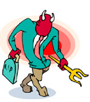
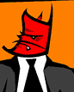
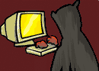
Distributed Denial of Service (DDoS) Attacks
(Elements)
Victim (Target)
Attack Daemon Agents
  agent programs that actually carry out the attack on victim
  attacker gain access and infiltrate the host computer to deploy them
  daemons affect both the target and the host computers
Master Program/Agent
  coordinates the attack through the attack daemons
Attacker/Attacking Hosts
  mastermind behind the attack
  using the master, it stays behind the scenes during real attack

Slide 47
Typical Distributed Denial of Service (DDoS) Attacks
In preparation for launching an attack, attacker sets up a DDoS attack network
  one or more attacking hosts
  number of masters
  large number of attack daemons (also referred to as zombies)
Each attacking host controls one or more masters
Each master in turn connects to a group of attack daemon
Denial of Service DDoS Attacks Solutions to DDoS Attacks Performance of Queuing algorithms under
DDoS Attack

Slide 48
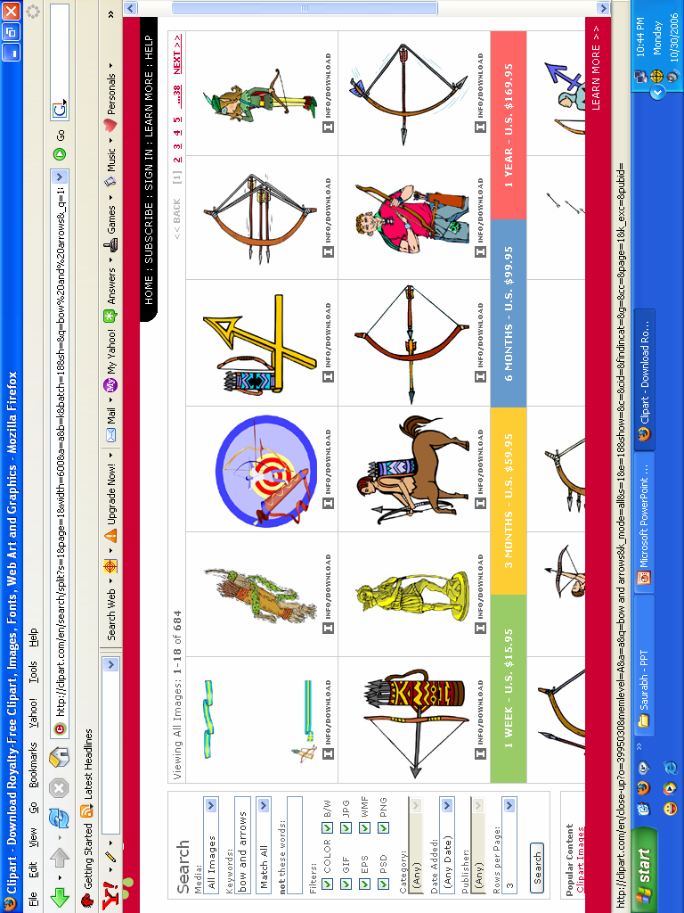

Typical Distributed Denial of Service (DDoS) Attacks
(contd..)
With attack network ready
Attack hosts launch an ‘attack’ command with
  victim’s address
  attack duration
  attack method, etc
Master program propagates the command to the attack daemons under its control
Upon receiving the attack command daemons begin the attack on the victim

Slide 49
Bandwidth/Throughput Attacks
Ping Flood Attack (ICMP echo)
SYN Flood Attack (DoS attack)
Distributed SYN Flood(DDoS Attack )
UDP Flood Attacks

Slide 50
Ping Flood Attack
An attempt by an attacker on a high bandwidth connection to saturate a network with ICMP echo request packets in order to slow or stop legitimate traffic going through the network.

Slide 51
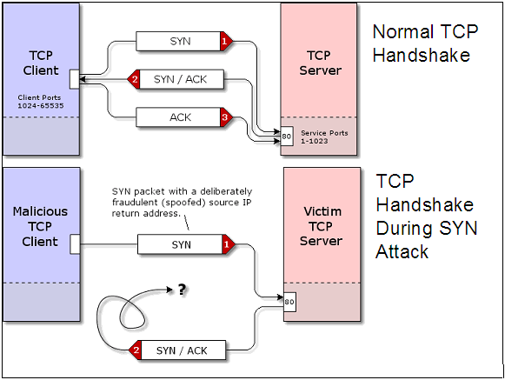
SYN Flood Attack
    Exploits TCP 3-way handshake
    attacker sends barrage of initial SYNs with spoofed addresses leaving the victim in half-open state, waiting for the non-existent ACKs and retransmitting
    victim’s resources for new connections exhausted by these half-open connections

Slide 52
TCP SYN flood
SYN RQST
server
client
SYN ACK
zombie
victim
Waiting queue overflows
Zombies
SYN ACK
Spoofed SYN RQST

Slide 53
DDoS Attack
The idea behind this attack is focusing Internet connection bandwidth of many machines upon one or a few machines. This way it is possible to use a large array of smaller (or “weaker”) widely distributed computers to create the big flood effect.

Slide 54
UDP Flood Attacks
UDP protocol is a connectionless unreliable protocol which doesn't require session negotiation between client and server application. UDP provides easy to use interface for producing large quantity of packets.
A common attack which exploits UDP simply floods the network with UDP packets destined to a victim's host. Due to the relative simplicity of this protocol an attacker can produce large bandwidth capacity with relatively small effort.

Slide 55
Protocol Attacks
Smurf Attack
DNS name server Attack

Slide 56
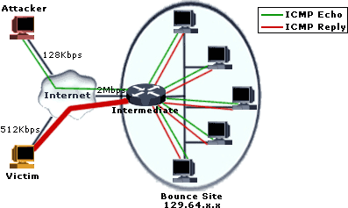
Smurf Attack
In this attack, spoofed IP packets containing ICMP Echo-Request with a source address equal to that of the attacked system and a broadcast destination address are sent to the intermediate network.
Sending a ICMP Echo Request to a broadcast address triggers all hosts included in the network to respond with an ICMP response packet, thus creating a large mass of packets which are routed to the victim's spoofed address.
    On a broadcast network, potentially hundreds of hosts could reply to each ICMP Packet
    This process of using intermediate network devices to elicit many responses to a single packet has been labeled as an “amplifier” process
    Amplifier as well as the target victim are impacted
    This method overloads an entire network

Slide 57
DDoS Tools and Their Attack Methods
Trinoo UDP
Tribe Flood Network (TFN) UDP, ICMP, SYN, Smurf
Stacheldracht UDP, ICMP, SYN, Smurf
TFN 2K UDP, ICMP, SYN, Smurf
Shaft UDP, ICMP, SYN

Slide 58
DNS name server Attack
The most common method seen involves an intruder sending a large number of UDP-based DNS requests to a Nameserver using a spoofed source IP address. Any Nameserver response is sent back to the spoofed IP address as the destination.
In this scenario, the spoofed IP address represents the victim of the denial of service attack. The Nameserver is an intermediate party in the attack.
The true source of the attack is difficult for an intermediate or a victim site to determine due to the use of spoofed source addresses.

Slide 59
Software Vulnerability Attacks
Ping of Death Attack
Fragmentation Attack and Teardrop Attack

Slide 60
Ping of Death Attack
Ping of Death is an attempt by an attacker to crash, reboot or freeze a system by sending an illegal ICMP (over IP) packet to the host under attack.
The TCP/IP specification allows for a maximum packet size of up to 65536 octets. In some TCP stack implementation encountering packets of greater size may cause the victim's host to crash.
Most implementations of the ICMP protocol use packet header size of 8 octets but allow the user to specify larger packet header sizes.
In the attack, the ICMP packet is sent in the form of a fragmented message which, when reassembled is larger than the maximum legal IP packet size

Slide 61
Teardrop Attack
Teardrop attacks target a vulnerability in the way fragmented IP packets are reassembled.
Fragmentation is necessary when IP Datagrams are larger than the maximum transmission unit (MTU) of a network segment across which the Datagrams must traverse.
In order to successfully reassemble packets at the receiving end, the IP header for each fragment includes an offset to identify the fragment's position in the original un-fragmented packet.
In a Teardrop attack, packet fragments are deliberately fabricated with overlapping offset fields causing the host to hang or crash when it tries to reassemble them.

Slide 62
Damage & Costs
Hidden Costs: There may be hidden costs associated with denial-of-service attacks. For example, the direct target of a DoS attack may not be the only victim. An attack against one site may affect network resources that serve multiple sites.
Bandwidth wastage: Resources we share with other parties (upstream bandwidth) may be consumed by an attack on someone else—another customer of our Internet service provider is attacked, so our upstream connections and routers are not as available to handle our legitimate traffic. Thus, even when we are not the target of an attack, we might experience increased network latency and packet loss, or possibly a complete outage.

